Slide 1
Cryptography Unit ‘2’ Part 1 Symmetric Ciphers
Prepared By: Abhishek Dewan
Lecturer, Cryptography

Slide 2
FEISTEL CIPHER/ FEISTEL BLOCK CIPHER
Feistel Cipher is not a specific scheme of block cipher.
It is a design model from which many different block ciphers are derived.
DES is just one example of a Feistel Cipher.
A cryptographic system based on Feistel cipher structure uses the same algorithm for both encryption and decryption.

Slide 3
Encryption Process
The encryption process uses the Feistel structure consisting multiple rounds of processing of the plaintext,
each round consisting of a “substitution” step followed by a “permutation” step.
Feistel Structure is shown in the following illustration −

Slide 4
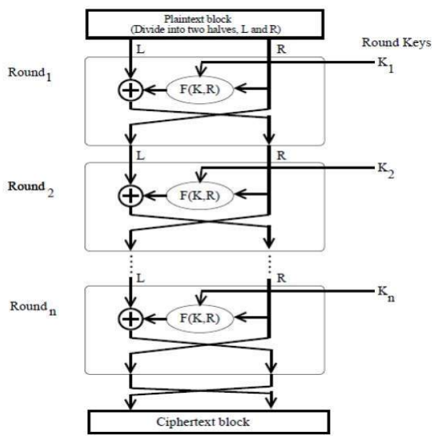

Slide 5
The input block to each round is divided into two halves that can be denoted as L and R for the left half and the right half.
In each round, the right half of the block, R, goes through unchanged.
But the left half, L, goes through an operation that depends on R and the encryption key.

Slide 6
First, we apply an encrypting function ‘f’ that takes two input − the key K and R.
The function produces the output f_{R, K}.
Then, we XOR the output of the mathematical function with L.

Slide 7
In real implementation of the Feistel Cipher, such as DES, instead of using the whole encryption key during each round, a round-dependent key “subkey” is derived from the encryption key.
This means that each round uses a different key, although all these subkeys are related to the original key.
The permutation step at the end of each round swaps the modified L and unmodified R.

Slide 8
Therefore, the L for the next round would be R of the current round.
And R for the next round be the output L of the current round.
Above substitution and permutation steps form a ‘round’. The number of rounds are specified by the algorithm design.
Once the last round is completed then the two sub blocks, ‘R’ and ‘L’ are concatenated in this order to form the ciphertext block.

Slide 9
The difficult part of designing a Feistel Cipher is selection of round function ‘f’.
In order to be unbreakable scheme, this function needs to have several important properties that are beyond the scope of our discussion.

Slide 10
Decryption Process
The process of decryption in Feistel cipher is almost similar to encryption.
Instead of starting with a block of plaintext, the ciphertext block is fed into the start of the Feistel structure and then the process thereafter is exactly the same as described in the given illustration.

Slide 11
The process is said to be almost similar and not exactly same. In the case of decryption, the only difference is that the subkeys used in encryption are used in the reverse order.
The final swapping of ‘L’ and ‘R’ in last step of the Feistel Cipher is essential. If these are not swapped then the resulting ciphertext could not be decrypted using the same algorithm.

Slide 12
Number of Rounds
The number of rounds used in a Feistel Cipher depends on desired security from the system.
More number of rounds provide more secure system.
But at the same time, more rounds mean the inefficient slow encryption and decryption processes.
Thus, Number of rounds in the systems thus depend upon efficiency–security tradeoff.

Slide 13
Substitution/Permutation Network
A Substitution/Permutation network, also known as a SP network (SPN), is a class of block cipher which comprises several rounds, each round being a substitution, a permutation, and the addition of key material

Slide 14
Such a network takes a block of the plaintext and the key as inputs, and applies several alternating "rounds" or "layers" of substitution boxes (S-boxes) and permutation boxes (P-boxes) to produce the ciphertext block.
The S-boxes and P-boxes transform (sub-)blocks of input bits into output bits.

Slide 15
Decryption is done by simply reversing the process (using the inverses of the S-boxes and P-boxes and applying the round keys in reversed order)
An S-box substitutes a small block of bits (the input of the S-box) by another block of bits (the output of the S-box)

Slide 16
A P-box is a permutation of all the bits: it takes the outputs of all the S-boxes of one round, permutes the bits, and feeds them into the S-boxes of the next round.
A single typical S-box or a single P-box alone does not have much cryptographic strength: an S-box could be thought of as a substitution cipher, while a P-box could be thought of as a transposition cipher.

Slide 17
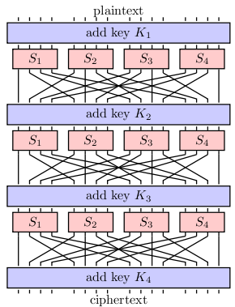
Substitution/Permutation network with three rounds:

Slide 18
The four keys K₁, K₂, K₃, and K₄, are derived from a single key.
This series of keys is called a key schedule and the derived keys are called round keys/subkeys.

Slide 19
Data Encryption Standard (DES) Algorithm
The Data Encryption Standard (DES) is a symmetric-key block cipher algorithm published by the National Institute of Standards and Technology (NIST).
DES is an implementation of a Feistel Cipher.
It uses 16 round Feistel structure.

Slide 20
The block size is 64-bit. which means 64 bits of plain text go as the input to DES, which produces 64 bits of ciphertext.
Though, key length is 64-bit, DES has an effective key length of 56 bits.
every 8th bit of the key is discarded to produce a 56-bit key. That is bit positions 8, 16, 24, 32, 40, 48, 56, and 64 are discarded.

Slide 21
DES is a block cipher--meaning it operates on plaintext blocks of a given size (64-bits) and returns ciphertext blocks of the same size.
Thus DES results in a permutation among the 2^64 (read this as: "2 to the 64th power") possible arrangements of 64 bits, each of which may be either 0 or 1.
Each block of 64 bits is divided into two blocks of 32 bits each, a left half block L and a right half R. (This division is only used in certain operations.)

Slide 22
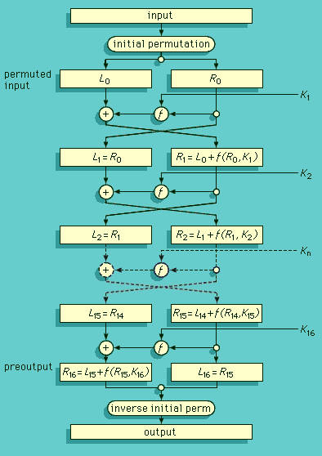

Slide 23
How DES Works
Example: Let M be the plain text message.
M = 0000 0001 0010 0011 0100 0101 0110 0111 1000 1001 1010 1011 1100 1101 1110 1111
Then,
L = 0000 0001 0010 0011 0100 0101 0110 0111
R = 1000 1001 1010 1011 1100 1101 1110 1111

Slide 24
Let K be the key ,
K = 00010011 00110100 01010111 01111001 10011011 10111100 11011111 11110001

Slide 25
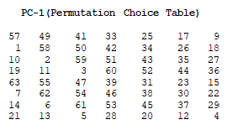
Step 1: Create 16 subkeys, each of which is 48-bits long
The 64-bit key is permuted according to the following table, PC-1.

Slide 26
Since the first entry in the table is "57", this means that the 57th bit of the original key K becomes the first bit of the permuted key K+.
Note only 56 bits of the original key appear in the permuted key.

Slide 27
From the original 64-bit key
K = 00010011 00110100 01010111 01111001 10011011 10111100 11011111 11110001
we get the 56-bit permutation,
K+ = 1111000 0110011 0010101 0101111 0101010 1011001 1001111 0001111

Slide 28
Next, split this key into left and right halves, C₀ and D₀, where each half has 28 bits.
From the permuted key K+, we get
C₀ = 1111000 0110011 0010101 0101111 D₀ = 0101010 1011001 1001111 0001111

Slide 29
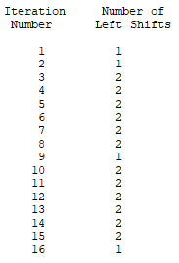
C₀ and D₀ defined, we now create sixteen blocks C_{n} and D_{n}, 1<=n<=16. Each pair of blocks C_{n} and D_{n} is formed from the previous pair C_{n-1} and D_{n-1}, respectively, for n = 1, 2, ..., 16, using the following schedule of "left shifts" table.

Slide 30
This means, for example, C₃ and D₃ are obtained from C₂ and D₂, respectively, by two left shifts, and C₁₆ and D₁₆ are obtained from C₁₅ and D₁₅, respectively, by one left shift.

Slide 31
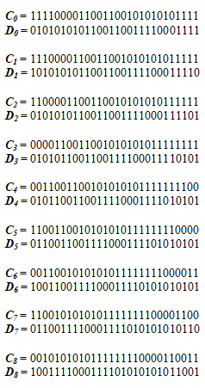
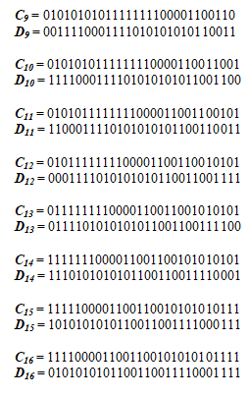
From original pair pair C₀ and D₀ we obtain:

Slide 32
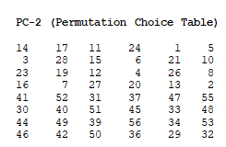
We now form the keys K_{n}, for 1<=n<=16, by applying the following permutation table to each of the concatenated pairs C_{n}D_{n}. Each pair has 56 bits, but PC-2 only uses 48 bits of these.

Slide 33
Therefore, the first bit of K_{n} is the 14th bit of C_{n}D_{n}, the second bit the 17th, and so on, ending with the 48th bit of K_{n} being the 32th bit of C_{n}D_{n}.
For the first key we have C₁D₁ = 1110000 1100110 0101010 1011111 1010101 0110011 0011110 0011110
which, after we apply the permutation PC-2, becomes
K₁ = 000110 110000 001011 101111 111111 000111 000001 110010

Slide 34
For the other keys we have:
K₂ = 011110 011010 111011 011001 110110 111100 100111 100101 K₃ = 010101 011111 110010 001010 010000 101100 111110 011001 K₄ = 011100 101010 110111 010110 110110 110011 010100 011101 K₅ = 011111 001110 110000 000111 111010 110101 001110 101000 K₆ = 011000 111010 010100 111110 010100 000111 101100 101111 K₇ = 111011 001000 010010 110111 111101 100001 100010 111100 K₈ = 111101 111000 101000 111010 110000 010011 101111 111011 K₉ = 111000 001101 101111 101011 111011 011110 011110 000001 K₁₀ = 101100 011111 001101 000111 101110 100100 011001 001111 K₁₁ = 001000 010101 111111 010011 110111 101101 001110 000110 K₁₂ = 011101 010111 000111 110101 100101 000110 011111 101001 K₁₃ = 100101 111100 010111 010001 111110 101011 101001 000001 K₁₄ = 010111 110100 001110 110111 111100 101110 011100 111010 K₁₅ = 101111 111001 000110 001101 001111 010011 111100 001010 K₁₆ = 110010 110011 110110 001011 000011 100001 011111 110101

Slide 35
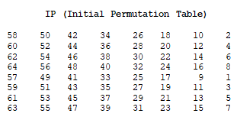
Step 2: Encode each 64-bit block of data.
There is an initial permutation IP of the 64 bits of the message data M according to the following table.

Slide 36
Applying the initial permutation to the block of text M, given previously, we get:
M = 0000 0001 0010 0011 0100 0101 0110 0111 1000 1001 1010 1011 1100 1101 1110 1111
IP = 1100 1100 0000 0000 1100 1100 1111 1111 1111 0000 1010 1010 1111 0000 1010 1010
Here the 58th bit of M is "1", which becomes the first bit of IP.

Slide 37
Next divide the permuted block IP into a left half L₀ of 32 bits, and a right half R₀ of 32 bits.
From IP, we get L₀ and R₀
L₀ = 1100 1100 0000 0000 1100 1100 1111 1111 R₀ = 1111 0000 1010 1010 1111 0000 1010 1010

Slide 38
Now, L_{n} = R_{n-1} R_{n} = L_{n-1} + f(R_{n-1},K_{n})
Example: For n = 1, we have
K₁ = 000110 110000 001011 101111 111111 000111 000001 110010 L₁ = R₀ = 1111 0000 1010 1010 1111 0000 1010 1010 R₁ = L₀ + f(R₀,K₁)

Slide 39
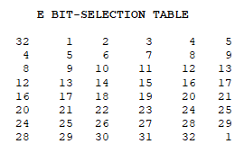
To calculate f, we first expand each block R_{n-1} from 32 bits to 48 bits using following table:

Slide 40
We calculate E(R₀) from R₀ as follows:
R₀ = 1111 0000 1010 1010 1111 0000 1010 1010
E(R₀) = 011110 100001 010101 010101 011110 100001 010101 010101
Note that each block of 4 original bits has been expanded to a block of 6 output bits.

Slide 41
Next in the f calculation, we XOR the output E(R_{n-1}) with the key K_{n}:
K_{n} + E(R_{n-1}).
For K₁ , E(R₀), we have
K₁ = 000110 110000 001011 101111 111111 000111 000001 110010 E(R₀) = 011110 100001 010101 010101 011110 100001 010101 010101 K₁+E(R₀) = 011000 010001 011110 111010 100001 100110 010100 100111.

Slide 42
We now use each group of six bits as addresses in tables called "S boxes".
Located at that address will be a 4 bit number. This 4 bit number will replace the original 6 bits.
The net result is that the eight groups of 6 bits are transformed into eight groups of 4 bits for 32 bits.

Slide 43
Write the previous result, which is 48 bits, in the form:
K_{n} + E(R_{n-1}) =B₁B₂B₃B₄B₅B₆B₇B₈,
where each B_{i} is a group of six bits.
We now calculate
S₁(B₁)S₂(B₂)S₃(B₃)S₄(B₄)S₅(B₅)S₆(B₆)S₇(B₇)S₈(B₈)
block B₁ will be mapped to a new value pointed by S-Box S₁, block B₂ to a new value pointed by S-Box S₂ & so on.

Slide 44
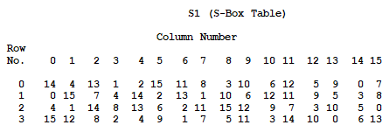

Slide 45
For example, for input block B = 011011 the first bit is "0" and the last bit "1" giving 01 as the row.
The middle four bits are "1101".
This is the binary equivalent of decimal 13, so the column is column number 13.
In row 1, column 13 appears 5.
This determines the output; 5 is binary 0101, so that the output is 0101. Hence S₁(011011) = 0101.

Slide 46
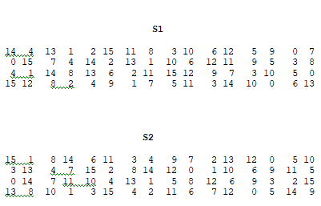
We use 8 such S-Boxes: S1, S2, S3, S4, S5, S6, S7, S8 for each 8 blocks:
The tables defining the functions S₁,...,S₈ are the following:

Slide 47
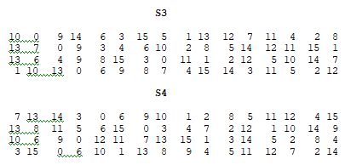
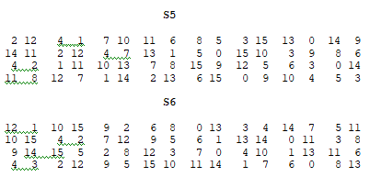

Slide 48
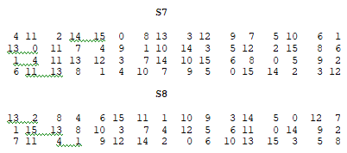

Slide 49
K₁ + E(R₀) = 011000 010001 011110 111010 100001 100110 010100 100111.
S₁(B₁)S₂(B₂)S₃(B₃)S₄(B₄)S₅(B₅)S₆(B₆)S₇(B₇)S₈(B₈) = 0101 1100 1000 0010 1011 0101 1001 0111

Slide 50
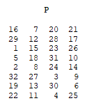
The final stage in the calculation of f is to do a permutation P of the S-box output using following table:

Slide 51
S₁(B₁)S₂(B₂)S₃(B₃)S₄(B₄)S₅(B₅)S₆(B₆)S₇(B₇)S₈(B₈) = 0101 1100 1000 0010 1011 0101 1001 0111
we get
f = 0010 0011 0100 1010 1010 1001 1011 1011

Slide 52
Now, calculate
R₁ = L₀ + f(R₀ , K₁ )
= 1100 1100 0000 0000 1100 1100 1111 1111 + 0010 0011 0100 1010 1010 1001 1011 1011 = 1110 1111 0100 1010 0110 0101 0100 0100
Similarly, R₂ =L₁ + f(R₁, K₂),

Slide 53
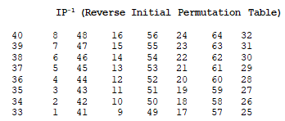
At the end of the sixteenth round we have the blocks L₁₆ and R₁₆. We then reverse the order of the two blocks into the 64-bit block
R₁₆L₁₆
and apply a final permutation IP⁻¹ by using following table:

Slide 54
If we process all 16 blocks using the method defined previously, we get, on the 16th round,
L₁₆ = 0100 0011 0100 0010 0011 0010 0011 0100 R₁₆ = 0000 1010 0100 1100 1101 1001 1001 0101

Slide 55
We reverse the order of these two blocks and apply the final permutation to
R₁₆L₁₆ = 00001010 01001100 11011001 10010101 01000011 01000010 00110010 00110100
IP⁻¹ = 10000101 11101000 00010011 01010100 00001111 00001010 10110100 00000101
Which is our cipher text.

Slide 56
DES CRACKED
In 1998, Under the direction of John Gilmore of the EFF, a team spent $220,000 and built a machine that can go through the entire 56-bit DES key space in an average of 4.5 days.
On July 17, 1998, they announced they had cracked a 56-bit key in 56 hours.
The computer, called Deep Crack, uses 27 boards each containing 64 chips, and is capable of testing 90 billion keys a second.

Slide 57
Weak keys in DES
A weak key is the one which after parity drop operation, consists either of all 0's,all 1's or half 0's and half 1's
Four out of the 2⁵⁶ keys are weak keys.

Slide 58
what the key scheduling algorithms does it just permutates and shift operations.
so if we do with the shift operation and permutation for this bits it almost results the same. That means there is non-linearity in the key scheduling its just transposition.
so these keys are considered as the weak keys
If we encrypt a block with a weak key and subsequently encrypt the result with the same weak key, we get the original block.

Slide 59
To prevent the drawbacks of DES, double DES and triple DES were introduced which are much more secured than the original DES because it uses 112 and 168 bit keys respectively.
They offer much more security than DES.

Slide 60
Double DES:
Double DES is a encryption technique which uses two instance of DES on same plain text.
In both instances it uses different keys to encrypt the plain text. Both keys are required at the time of decryption.
The 64 bit plain text goes into first DES instance which then converted into a 64 bit middle text using the first key,
and then it goes to second DES instance which gives 64 bit cipher text by using second key.

Slide 61
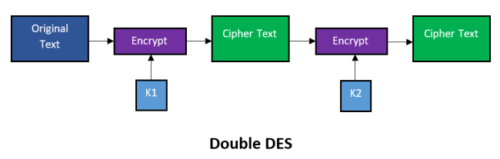

Slide 62
Triple DES
3-KEY Triple DES
there are two variants of Triple DES known as 3-key Triple DES (3TDES) and 2-key Triple DES (2TDES).
Before using 3TDES, user first generates and distributes a 3TDES key K, which consists of three different DES keys K₁, K₂ and K₃.
This means that the actual 3TDES key has length 3×56 = 168 bits.

Slide 63
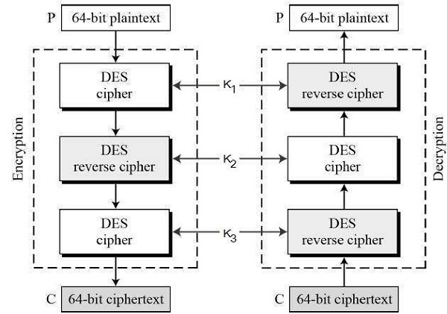
The encryption scheme is illustrated as follows −

Slide 64
The encryption-decryption process is as follows −
1) Encrypt the plaintext blocks using single DES with key K₁.
2) Now decrypt the output of step 1 using single DES with key K₂.
3) Finally, encrypt the output of step 2 using single DES with key K₃.
The output of step 3 is the ciphertext.

Slide 65
Decryption of a ciphertext is a reverse process.
User first decrypt using K_{3,} then encrypt with K_{2,} and finally decrypt with K₁.

Slide 66
2 KEY Triple DES
Triple DES (2TDES) is identical to 3TDES except that K₃is replaced by K₁.
In other words, user encrypt plaintext blocks with key K_{1,} then decrypt with key K_{2,} and finally encrypt with K₁ again.
Therefore, 2TDES has a key length of 112 bits.

